Slide 1
Cloudfarming LLC & Corner Stalk Farm Overview
February 8, 2023
and
October 31, 2023
Cannabis and Produce
50 Condor Street, Eagle Hill, East Boston
www.cornerstalk.com
www.cloudfarming.net

Slide 2
East Boston industrial zone farm location
Cloudfarming and Corner Stalk Farm
50 Condor Street

Slide 3
Corporate Structure of Cloudfarming LLC
Operating in East Boston Since September 2013
Constance Cooney is the primary partner at 51% ownership with Shawn Cooney at 49%
There are no other direct or indirect participants
Address of the Cloudfarming and the principals
77 Pond Street
Marblehead, MA 01945
Cloudfarming LLC, Constance Cooney and Shawn Cooney have no other cannabis licenses in Massachusetts in which any direct or indirect beneficial interest holders have no interest in and any pending licenses applied for in Massachusetts in which any direct or indirect beneficial interest holders has or may have an interest in.

Slide 4
City of Boston HCA Timeline
Initial Contact Alexis Finneran Tkachuk April 2018
Initial Presentation and Application to Alexis Finneran Tkachuk May 2018
Meeting with Lydia Edwards and Staff May 10 2018 at 3PM
ISD Filing June 2018
ISD denial August 2018
BOA Filing August 2018
Initial community meeting held by ONS December 2018 with neighborhood and representatives from Councilor Edwards’ and Representative Madaro’s offices
Second Licensing Process Application August 2020
Second community meeting held by ONS April 2021 with neighborhood and representatives from Councilor Edwards’ and Representative Madaro’s offices
Letter from BCB to District City Councilor Lydia Edwards April 13 2021
June 2 Councilor Edwards non response triggers Queue for BCB hearing
HCA and Boston Zoning approvals February 2022
Many Meetings with Adrian Madaro from 2013 through 2021
Many Meetings with Edward McGuire, Lina Tramelli and Jose Garcia-Mota

Slide 5
CloudFarming – Proposed timeline

Slide 6
2000 Square foot indoor farm at 50 Condor Street
Currently producing as much lettuce as a 4 acre farm
Converting 25% to 75% to cannabis Production

Slide 7
Fully Operational Farm - Bootstrapped
Investment - $500,000 in a fully BUILT OUT infrastructure
Automated farm – State of the art - lighting, fertigation, management, propagation, nursery, vegetation and bloom facility
R&D relationships with cutting edge vendors
Lighting, HVAC, Water, and Genetics, etc.
Experience
7 years of farm operation in Boston
Vice Chairman National Cannabis Industry Association FDC
Founder Sustainable Cannabis Coalition
Chairman ASTM Sustainable Cannabis Committee (D37.09)
Brand awareness in Metro-Boston in consumer and wholesale food arenas
Thousands of customers – individuals. Families, Most successful restaurants in Boston., Wholesaler channels
Media coverage local and national
Print, Radio, Internet, Television
From Edible Boston to CNN Money

Slide 8
Current Farm Overview
Produce Farm
Lettuce and Herbs
Named Corner Stalk Farm
Hemp Farm - MDAR License # MA20180011GP
Cultivation and Manufacturing ONLY - NO RETAIL
Grew in 2018 and 19 with no security problems
Called Cloudfarming LLC

Slide 9
Farm with Cannabis Overview
Corner Stalk Farm
Produce Farm
Lettuce and Herbs
Cloud Farming
Cannabis Farm
Cultivation and Manufacturing ONLY - NO RETAIL
Grow Cannabis plants
Eventually produce Oils, Rosin and Extracts

Slide 10
Cannabis’ fit Eagle Hill Neighborhood
Proposed location - 50 Condor Street / 17 Nay Street
Industrial Zone
700 feet from East Boston High School
1400 feet from Mario Umana School
2428.8 feet to
Berkshire Root - Timeline puts Cloudfarming application prior to Berkshire roots
More Than ½ mile to other neighborhood features
Central Square
Urban Wild
Day Square

Slide 11
Neighborhood involvement
News coverage of Farm and Cannabis Application By Frank Conte of EastBoston.com 3 times
Initial meeting with Eagle Hill Civic Association about Cannabis Application with neighborhood and representatives from Councilior Edwards’ and Representative Madaro’s offices April 2018
Second meeting with Eagle Hill Civic Association about Cannabis Application with neighborhood and representatives from Councilior Edwards’ and Representative Madaro’s offices April 2021
Long term relationships and outreach as Corner Stalk Farm and as Cannabis applicant with Representative Adrian Madaro, John Lebeaux Commissioner of MDAR
Long term relationships as Cornerstalk Farm with East Boston High, Eastie Farm, ENHC, NOAH, The Donald McKay School STEM program, Magdalena Ayed at Harborkeepers
Personal relationships with all our residential neighbors.

Slide 12
Continued or Greater Neighborhood Involvement

Slide 13
Diversity Equity and Inclusion – History and Plan
History at peak; Corner Stalk Farm | Supporting letter from Boston Public Market CEO
Women | 7
Men | 2
Disenfranchised Populations (CCC definition) | 8
East Boston Residents | 2
Boston Residents | 5
Wages | Started paying 15.00 in 2014
Previous Criminal Record | 0
Track and create all DEI data, programs and policies using Sustain.life software
Publish DEI reports to website and supervising authorities quarterly
Currently Creating Programs with Minority Cannabis Business Association and with the Diversity, Equity & Inclusion Committee of the NCIA
Webinars, training programs presentations for employees, Diversity applicants and interested people
Grow and create products for DEI retail, delivery and production companies in the City of Boston first
Target cultivation and production job training to management skills

Slide 14
Employment – Diversity Executed
Track all DEI data using Sustain.life software
Publish Sustain.Life reports to website and authorities quarterly
Local resources that will be utilized will at a minimum be, our neighborhood connections, Eagle Hill Civic Association, Mayors office of Workforce Development, Returning Citizens, Eastie Times, Eastboston.com, ElMundo and WeGrow Foundation
 | GOAL for year 1 - 8 employees
Women | Moved to Disenfranchised
Men | 25%
Disenfranchised Populations (CCC definition) | 75%
East Boston Residents | 30% increasing in out years
Boston Residents | 60% increasing in out years
Wages and Benefits | - 20.00 minimum – high production high value jobs, both salary and hourly -Targeting 70% of salary jobs for equity employees - Training - CCC, OSHA, Safety, Cultivation Technology - Benefit package - Paid Time Off, Health Insurance - BlueBike Membership($100/yr) or MBTA Pass subsidy
Previous Criminal Record | 5% Thru WeGrow Foundation

Slide 15
No Retail – Soft Security - Site Security
Early planning with Kroll, through Carl Jenkins (President)
No Retail
No Foot Traffic
No - Cash (transaction or storage), Checks or Card Processing
Soft security
Build on 7 years of neighborhood involvement
7 years of operation with no theft, break-in or vandalism
Growing Hemp since July 2018 with no security problems
Cannabis affords increased involvement
Hiring from neighborhood
Cannabis affords increased hiring
Site Security
Visually attractive perimeter fencing with auto locking gates, video monitors and motion activated lighting
24 hour video surveillance with 24 hour human monitoring
Monitoring site is within 500 feet of facility
Surveillance video recorded and stored to cloud

Slide 16
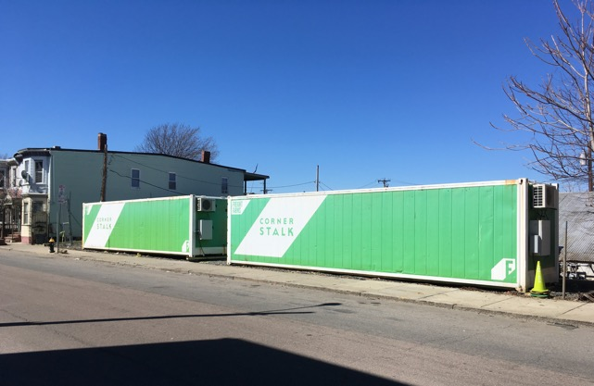
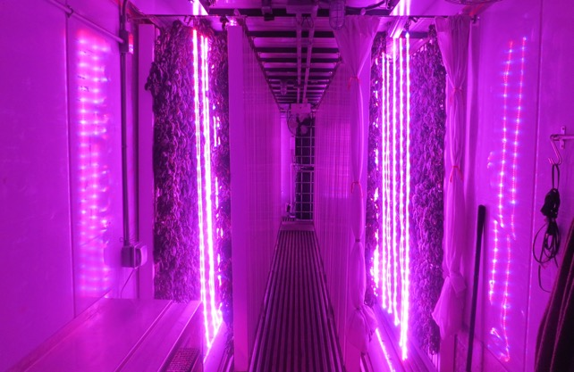
Secure by Design Structures
Modularity
Isolate access and functions
Growing units
Core10 steel superstructure
2 layer aluminum floors walls and roofing with R45 insulation
No windows with LED lighting and climate control

Slide 17
Security Systems Growing, Office and Manufacturing
Battery and generator backup for systems
Fire, Entry and Emergency Alarms
Surveillance direct to cloud with local backup
Work areas and access points
Thermal and Infrared motion activated off hours
Biometric and or key card and 2 factor authentication for Cannabis growing units and production areas
Auto-locking growing units and production areas
Doors and frames as robust as surrounding walls
Rules based access controls to all areas
All data recorded an stored to cloud database

Slide 18
Inside-0ut Security
CCC mandated Metrc seed to sale tracking will be tied to employee access and activities
Employee movement tracked and recorded via key card system
Tied to Metrc System Via API

Slide 19
Growth Plan Based on Planning and Success
Right of refusal on 20,000sq feet of land at current location
Build up to 60,000 sq feet of Indoor and Greenhouse
8 living wage jobs year 1
Maintain local control
Finance with Revenue based private debt offering vs, equity
Potential Wholesale of $48,000,000 flower revenue with possible 4X upside for extract production
Additional 20 management, manufacturing and production jobs for local residents
We are getting requests for production plans from companies working on developing or in the market with products for the retail market and from potential retailers looking for products that are not from competitors.

Slide 20
Cloudfarming LLC / Corner Stalk Farm
Connie & Shawn Cooney
www.cornerstalk.com
www.cloudfarming.net
@bostonurbanfarm
#cornerstalkfarm
shawn@cornerstalk.com
shawn.cooney@cloudfarming.net
connie@cornerstalk.com
connie.cooney@cloudfarming.net
978 764 7285

